Slide 1
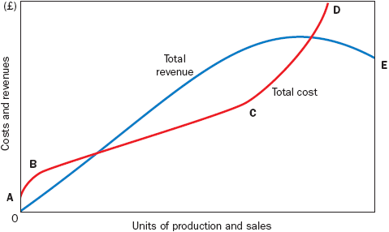
CURVILINEAR CVP RELATIONSHIPS
A curvilinear relationship is a type of relationship between two variables that has a pattern of correspondence or association between the two variables that change as the values of the variables change (increase or decrease).

Slide 2
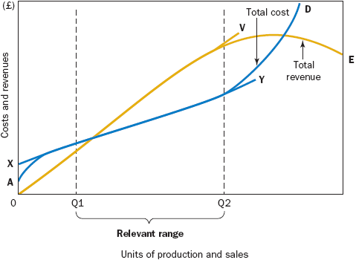
LINEAR CVP RELATIONS
Blue line XY- Total cost line
Yellow line 0V- Total revenue line

Slide 3
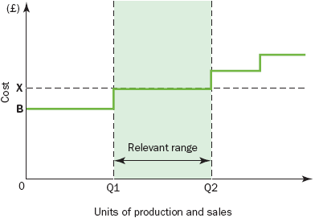
FIXED COST FUNCTIONS
Fixed costs refer to expenses that a company must pay, independent of any specific business activities. These costs are set over a specified period of time and do not change with production levels. Fixed costs can be direct or indirect and may influence profitability at different points on the income statement.

Slide 4
NUMERICAL APPROACH TO CVP
Norvik Enterprises operates in the leisure and entertainment industry and one of its activities is to promote concerts at locations throughout Europe. The company is examining the viability of a concert in Helsinki. Estimated fixed costs are £60,000. These include the fees paid to performers, the hire of the venue and advertising costs. Variable costs consist of the cost of a pre-packed buffet that will be provided by a firm of caterers at a price which is currently being negotiated, but it is likely to be in the region of £10 per ticket sold. The proposed price for the sale of a ticket is £20. The management of Norvik have requested the following information:
1. The number of tickets that must be sold to break even (that is, the point at which there is neither a profit nor loss).
2. How many tickets must be sold to earn £30,000 target profit?
3. What profit would result if 8,000 tickets were sold?
4. How many additional tickets must be sold to cover the extra cost of television advertising of £8,000?

Slide 5
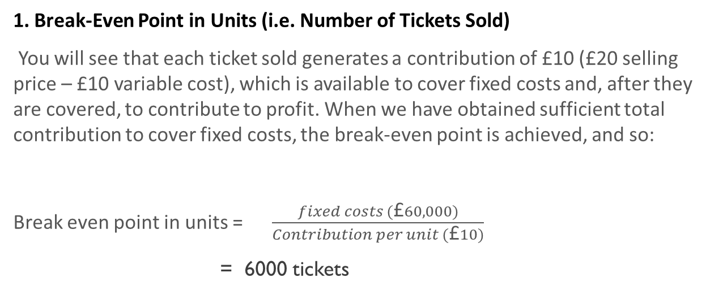
1. Break-Even Point in Units (i.e. Number of Tickets Sold)
You will see that each ticket sold generates a contribution of £10 (£20 selling price – £10 variable cost), which is available to cover fixed costs and, after they are covered, to contribute to profit. When we have obtained sufficient total contribution to cover fixed costs, the break-even point is achieved, and so:
Break even point in units = $\frac{fixed costs (\text{£}60,000)}{Contribution per unit (\text{£}10)}$
= 6000 tickets

Slide 6
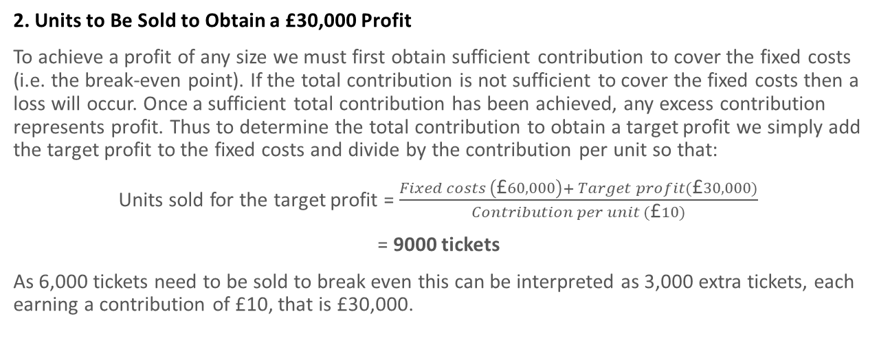
2. Units to Be Sold to Obtain a £30,000 Profit
To achieve a profit of any size we must first obtain sufficient contribution to cover the fixed costs (i.e. the break-even point). If the total contribution is not sufficient to cover the fixed costs then a loss will occur. Once a sufficient total contribution has been achieved, any excess contribution represents profit. Thus to determine the total contribution to obtain a target profit we simply add the target profit to the fixed costs and divide by the contribution per unit so that:
Units sold for the target profit = $\frac{Fixed costs \left(\text{£}60,000\right)+ Target profit(\text{£}30,000)}{Contribution per unit (\text{£}10)}$
= 9000 tickets
As 6,000 tickets need to be sold to break even this can be interpreted as 3,000 extra tickets, each earning a contribution of £10, that is £30,000.

Slide 7
3. Profit from the Sale of 8,000 Tickets
The total contribution from the sale of 8,000 tickets is £80,000 (8,000 × £10).
To ascertain the profit, we deduct the fixed costs of £60,000 giving a net profit of £20,000.
so now assume that we wish to ascertain the impact on profit if a further 1,000 tickets are sold so that sales volume increases from 8,000 to 9,000 tickets.
Assuming that fixed costs remain unchanged, the impact on a firm’s profits resulting from a change in the number of units sold can be determined by multiplying the unit contribution margin by the change in units sold. Therefore, the increase in profits will be £10,000 (1,000 units times a unit contribution margin of £10).

Slide 8
4. Additional Sales Volume to Meet £8,000 Additional Fixed Advertisement Charges
The contribution per unit is £10 and fixed costs will increase by £8,000. Therefore, an extra 800 tickets must be sold to cover the additional fixed costs of £8,000.

Slide 9
CONTRIBUTION MARGIN RATIO
If total sales revenue is estimated to be £200,000, the total contribution will be £100,000 (£200,000 × 0.5).
To calculate the profit, we deduct fixed costs of £60,000; thus a profit of £40,000 will be obtained from total sales revenue of £200,000.
Profit = ( Sales revenue x CM ratio) – Fixed costs
We can rearrange this equations as:
Profit + Fixed costs = Sales revenue x CM ratio
The break-even sales revenue (where profit = 0) = Fixed costs/ CM ratio

Slide 10
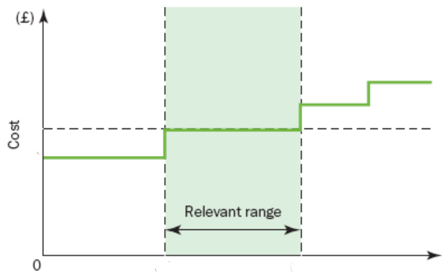
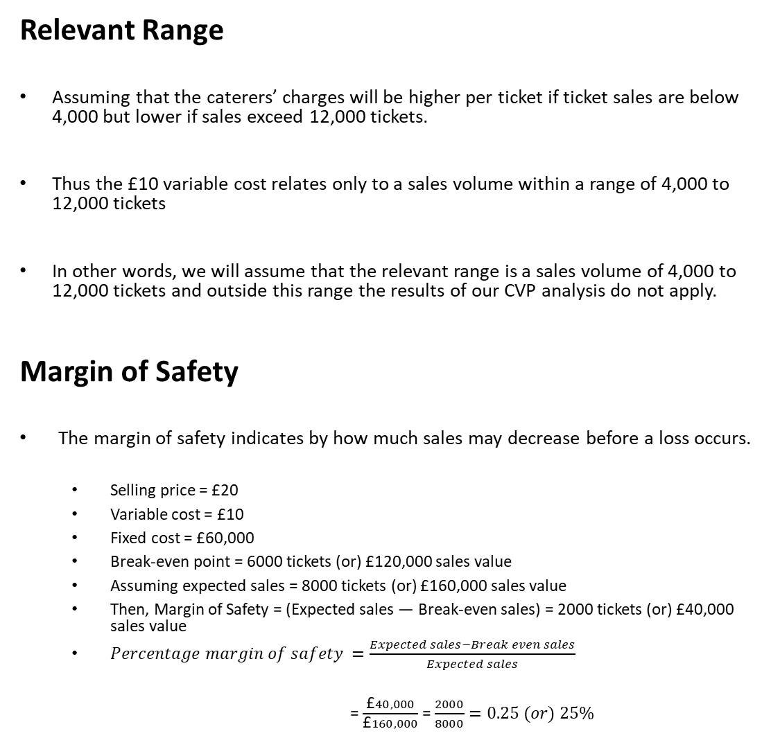
Relevant Range
Assuming that the caterers’ charges will be higher per ticket if ticket sales are below 4,000 but lower if sales exceed 12,000 tickets.
Thus the £10 variable cost relates only to a sales volume within a range of 4,000 to 12,000 tickets
In other words, we will assume that the relevant range is a sales volume of 4,000 to 12,000 tickets and outside this range the results of our CVP analysis do not apply.
Margin of Safety
The margin of safety indicates by how much sales may decrease before a loss occurs.
Selling price = £20
Variable cost = £10
Fixed cost = £60,000
Break-even point = 6000 tickets (or) £120,000 sales value
Assuming expected sales = 8000 tickets (or) £160,000 sales value
Then, Margin of Safety = (Expected sales ― Break-even sales) = 2000 tickets (or) £40,000 sales value
$Percentage margin of safety =\frac{Expected sales−Break even sales}{Expected sales}$
= $\frac{\text{£}40,000}{\text{£}160,000}$ = $\frac{2000}{8000}=0.25 (or) 25\%$
10
Ticket sales
12000
4000

Slide 11
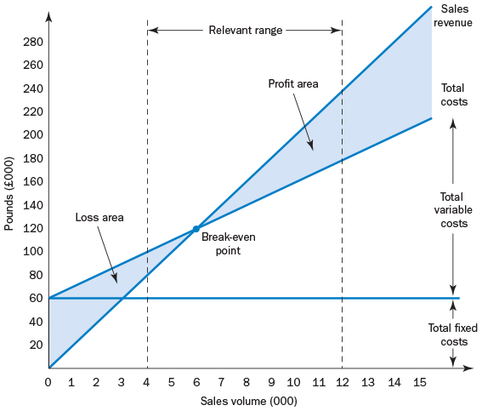
Break-Even or CVP Chart
The fixed costs are plotted as a single horizontal line at the £60,000 level.
Variable costs at the rate of £10 per unit of volume are added to the fixed costs to enable the total cost line to be plotted.
Two points are required to insert the total cost line. At zero sales volume the total cost will be equal to the fixed costs of £60,000. At 12,000 units sales volume, the total costs will be £180,000, consisting of £120,000 variable costs plus £60,000 fixed costs.
The total revenue line is plotted at the rate of £20 per unit of volume. At zero output total sales are zero and at 12,000 units total sales revenue is £240,000. The total revenues for these two points are plotted on the graph and a straight line is drawn that joins these points.
The constraints of the relevant range consisting of two vertical lines are then added to the graph; beyond these lines we have little assurance that the CVP relationships are valid.
The point at which the total sales revenue line cuts the total cost line is the point where the concert makes neither a profit nor a loss. This is the break-even point and is 6,000 tickets or £120,000 total sales revenue.

Slide 12
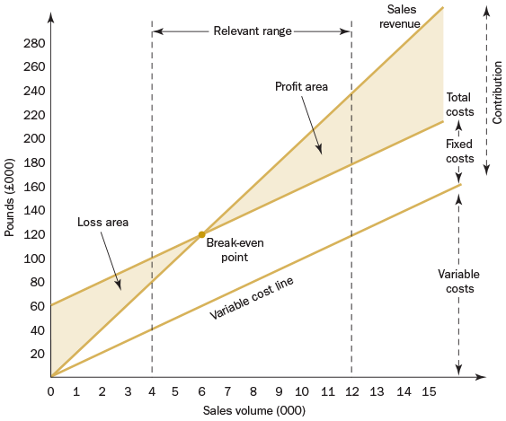
Contribution Graph

Slide 13
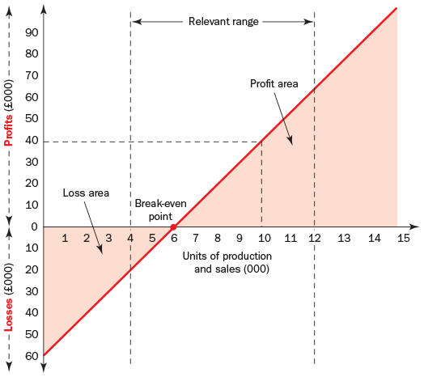
Profit - Volume Graph

Slide 14
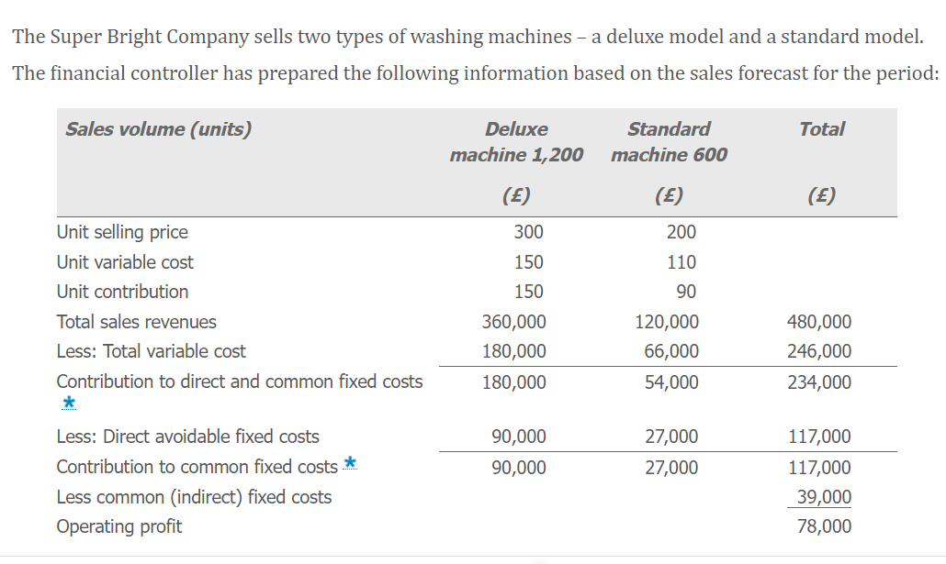
Multi product cvp analysis

Slide 15
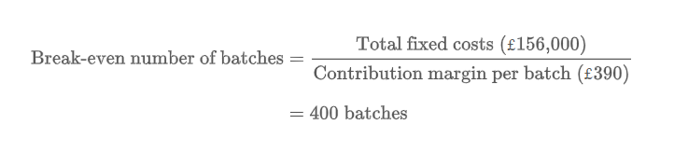
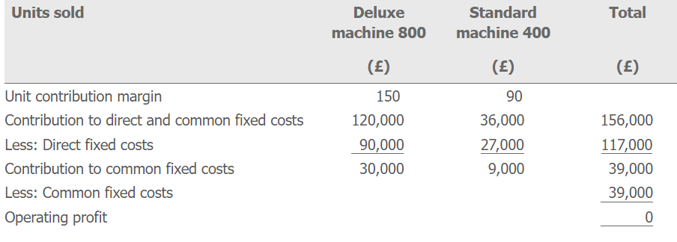
Multi product cvp analysis

Slide 16
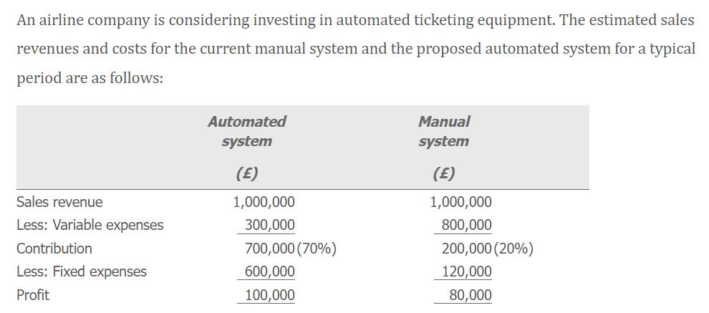
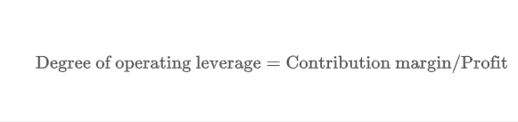
Operating leverage

Slide 17
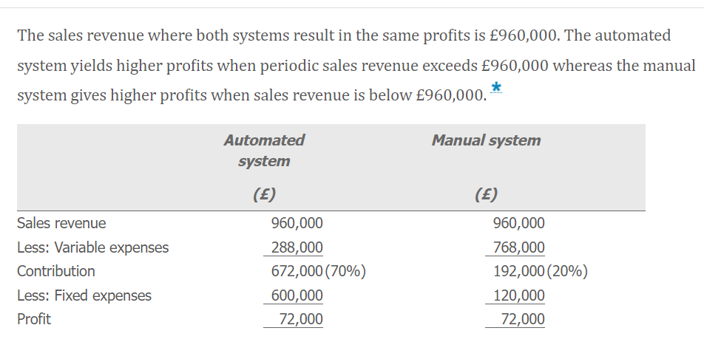
Operating leverage

Slide 18

CVP Analysis Assumptions
All other variables remain constant.
A single product or constant sales mix.
Total costs and total revenue are linear functions of output.
Costs can be accurately divided into their fixed and variable elements.
The analysis applies only to the relevant range.
The analysis applies only to a short-term time horizon.
Notes:
Cost–Volume–Profit Analysis Assumptions and Limitations
Most companies operate with the goal to maximize their profits in mind.
For these companies we have learned how that the cost volume profit analysis can help a decision-making process.
But, we need to remember that this tool is restricted to the following assumptions:
1. All other variables remain constant.
In here it is assumed that volume is the only factor that will cause costs and revenues to change
The technology, production methods and efficiency remain unchanged.
At this point we do not predict a pandemic situation will affect the business
2. A single product or constant sales mix.
We have learned how to define our standard batch of products, when we are analyzing more than one product.
3. Total costs and total revenue are linear functions of output.
We have seen in the beginning of the presentation that we only consider the linear fashion behavior.
4. Costs can be accurately divided into their fixed and variable elements.
All costs can be resolved into fixed and variable elements. Even though we have another types of costs but all of them need to be inside fixed or variable.
Five elements of cost: Direct Material, Direct Labor, Direct Expenses, Factory Overhead, Selling and Distribution and Administrative Overheads
5. The analysis applies only to the relevant range.
Inside the relevant range it is where the linear analysis applies.
Outside the relevant range it is dangerous to supposed anything.
6. The analysis applies only to a short-term time horizon.
The typically period used is 1 year

Slide 19

The Impact of Information Technology
What if the original estimates or the assumptions change.
Sensitivity Analysis
CVP computerized models
Notes:
What if the original estimates or the assumptions change.
Then Sensitivity analysis will take place and focuses on how a result will be changed
With The information technology , Cost Volume Profit can be computerized.
Then it can be considered an alternative when something changes.
Because it can quickly show changes both graphically and numerically.
So managers can study various combinations of changes in selling prices, fixed costs, variable costs and product mix.
Also can react fast without waiting for formal reports for example.

Slide 20
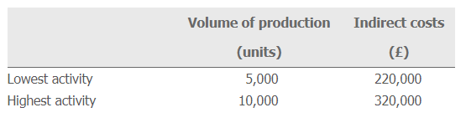
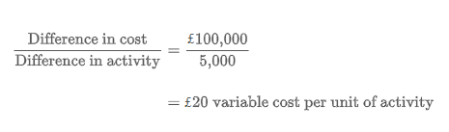
Separation of Costs into Their Fixed and Variable Elements
High-low Method
The fixed cost can be estimated by subtracting the variable cost portion from the total cost.
At an activity level of 5,000 units the total cost is £220,000 and the total variable cost is £100,000 (5,000 units at £20 per unit).
The balance of £120,000 is assumed to represent the fixed cost.
Notes:
CVP analysis assumes that costs can be accurately analyzed into their fixed and variable elements, and mathematical techniques can be used to separate costs in this way.
However in this course we are going to learn see the high–low method.
A method of analysing cost behaviour that consists of selecting the periods of highest and lowest activity levels and comparing the changes in costs that result from the two levels in order to separate fixed and variable costs.
The fixed cost can be estimated by subtracting the variable cost portion from the total cost.
At an activity level of 5,000 units the total cost is £220,000 and the total variable cost is £100,000 (5,000 units at £20 per unit).
The balance of £120,000 is assumed to represent the fixed cost.

Slide 21
Thank You

